Slide 1
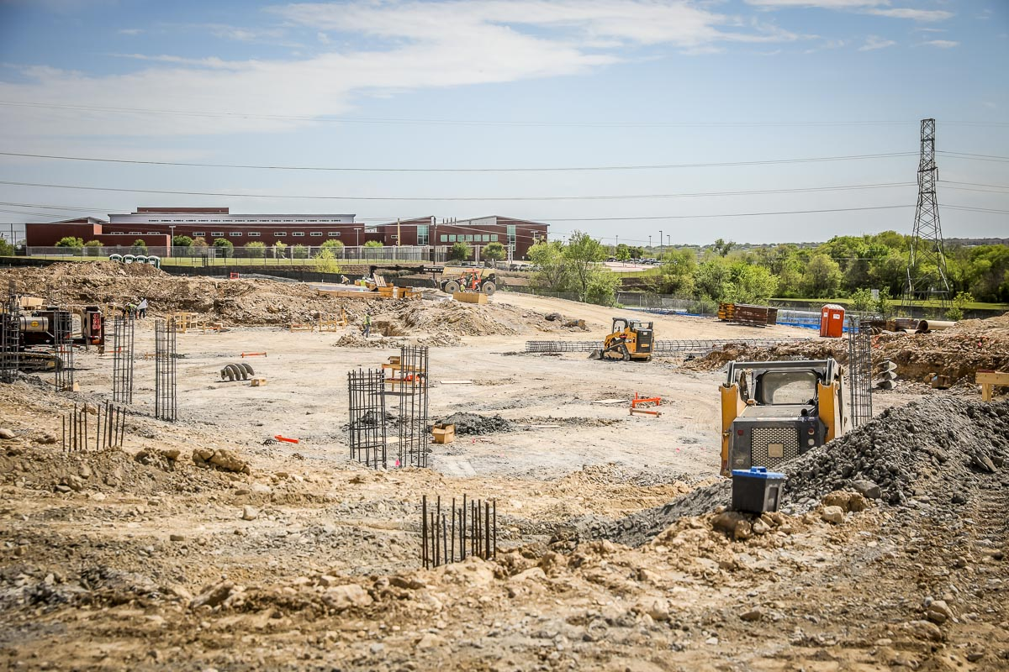
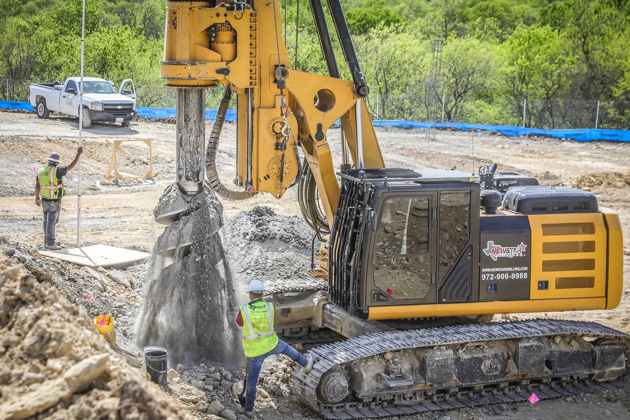
NEW ADMINISTRATION BUILDING
Piers are in the process of being drilled. They are filled with rebar and concrete, and 180 of the 300+ piers have been completed.

Slide 2
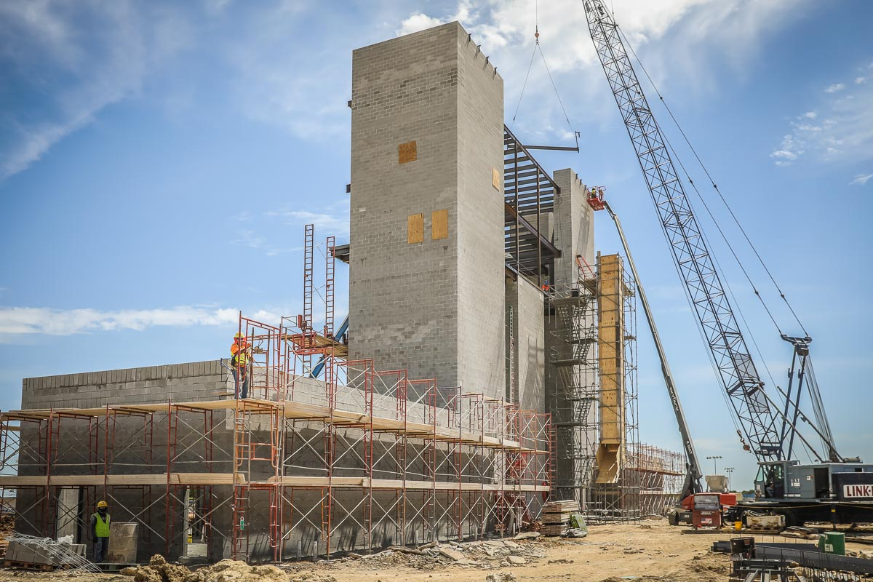
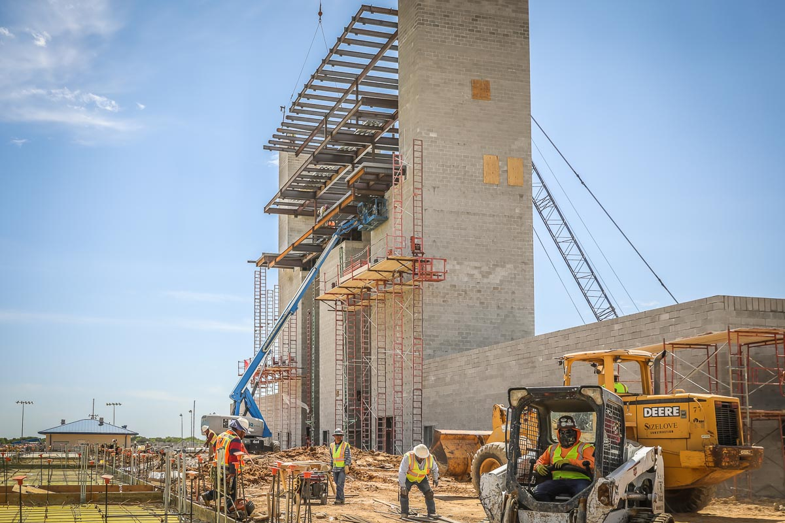
BOSWELL HS
CMU blocks have been completed for the press box and restrooms. Steel has been installed on levels 1, 2, and 3.

Slide 3
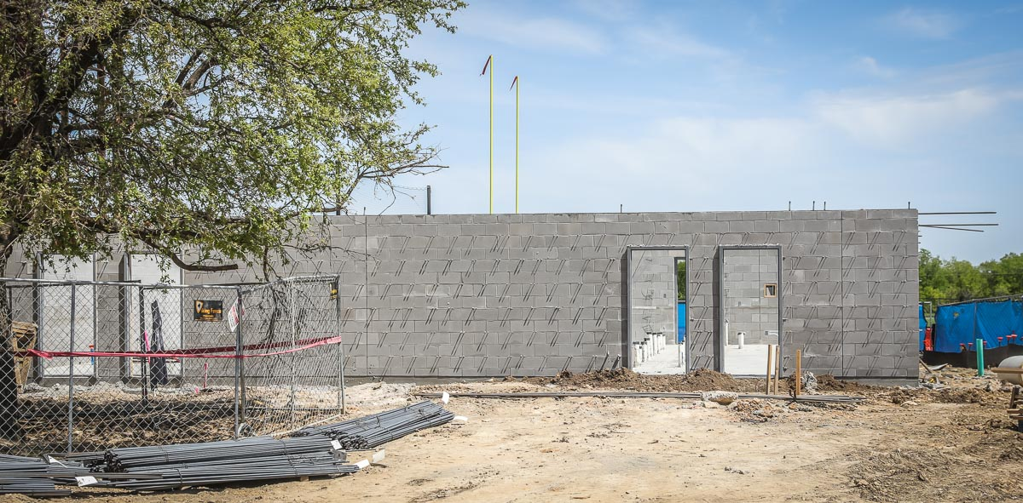
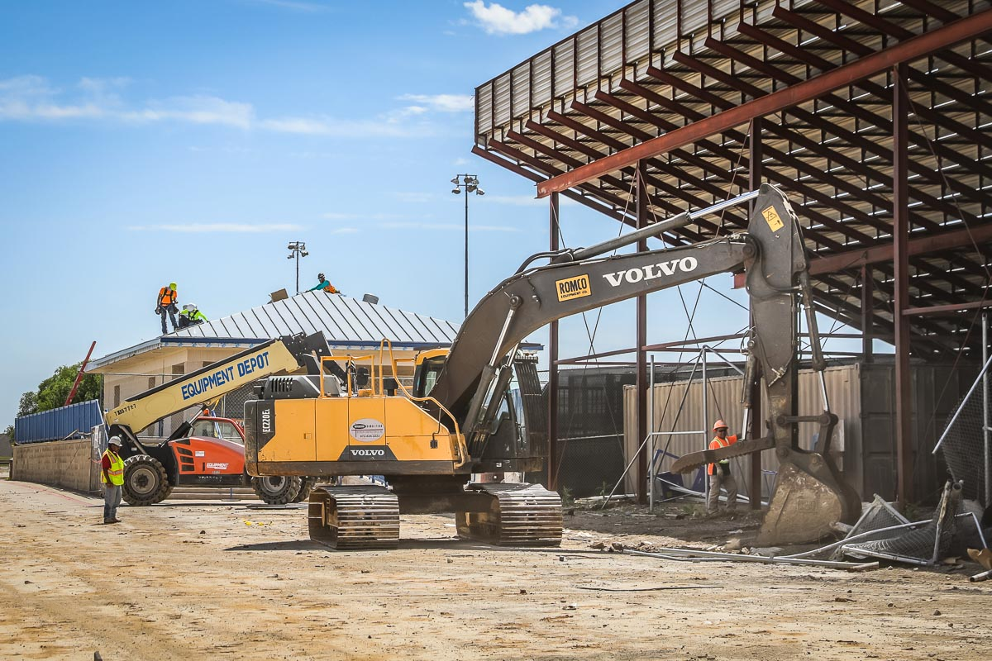
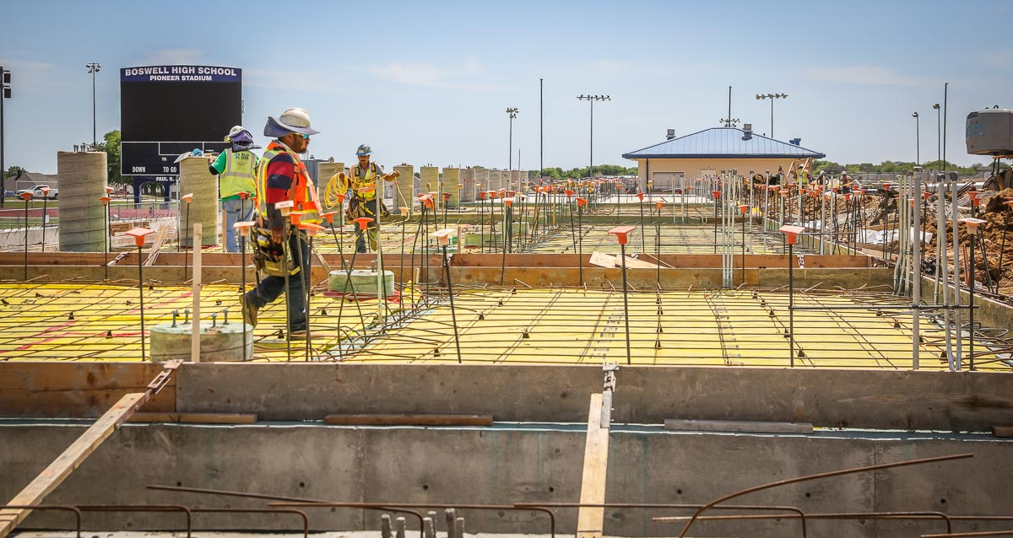
Storage area concrete is in the process of being poured. New concession stand CMU block and door jams are in place. Demolition of the visitor’s stands has begun.

Slide 4
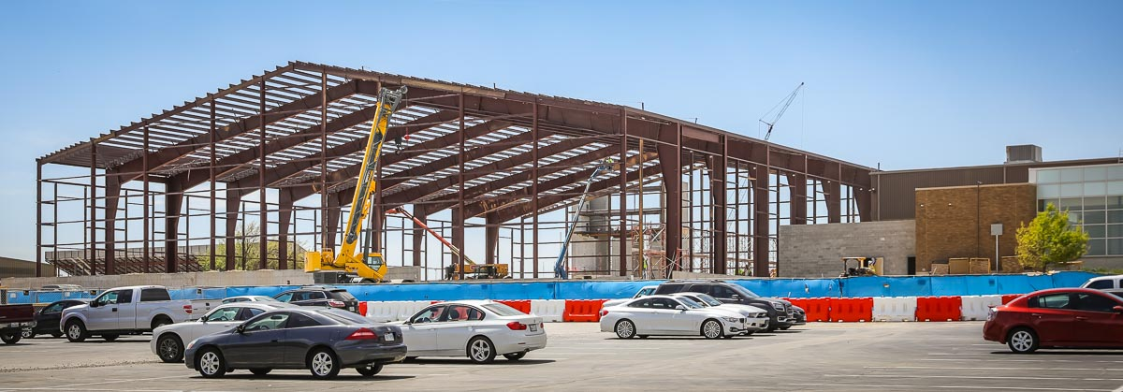
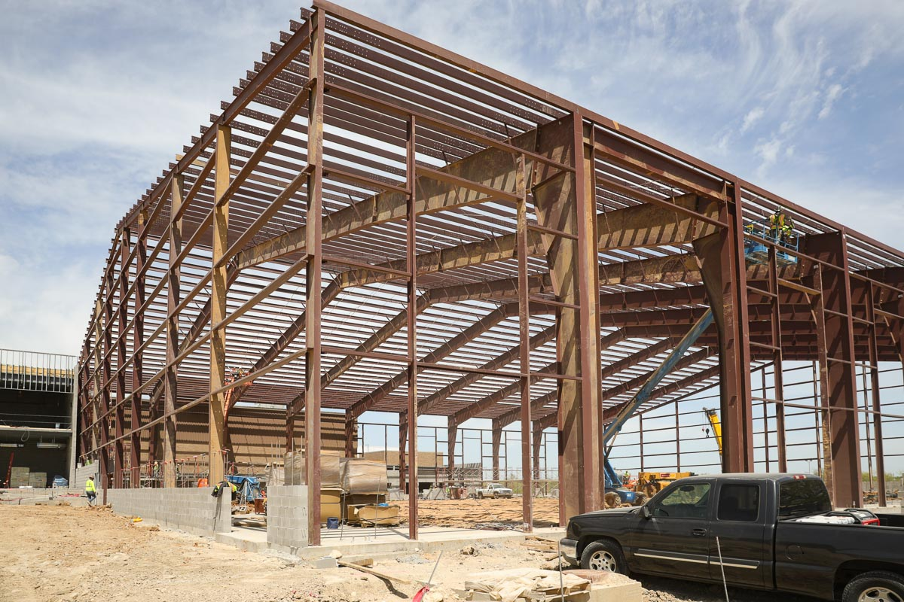
Structural framing on the turf room continues and will be completed within the next week.

Slide 5
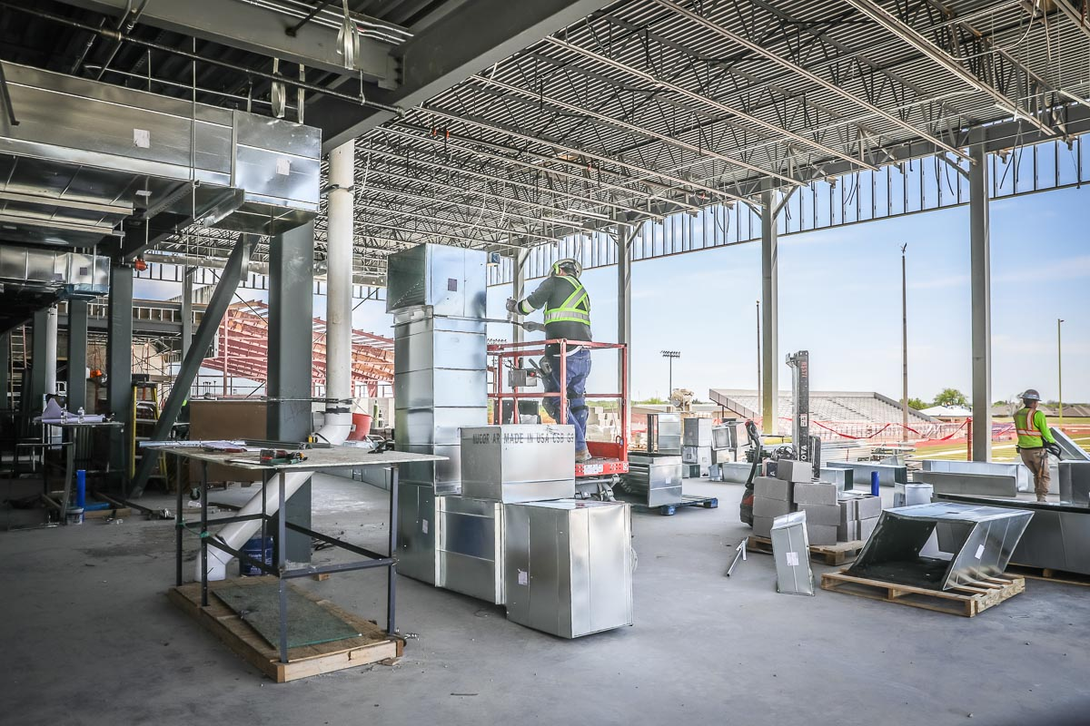
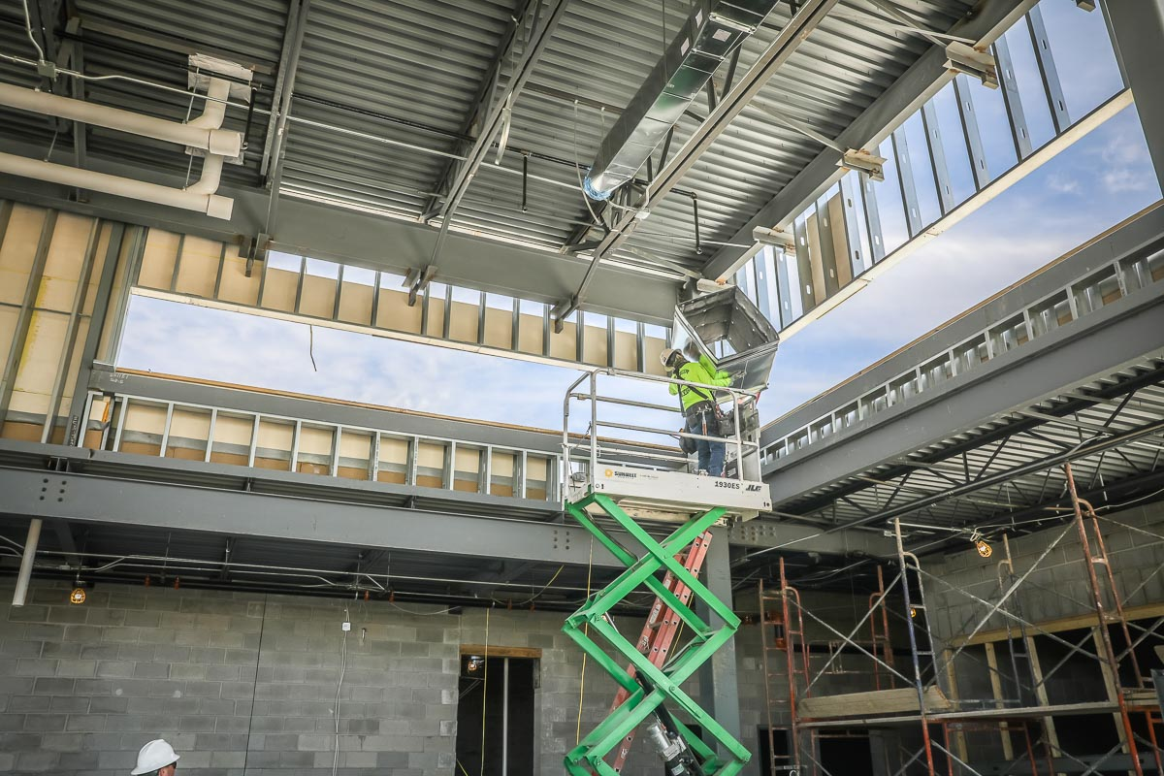
HVAC duct work is in the process of being installed in the weight room.
Installation of the glass in the weight room started last week.

Slide 6
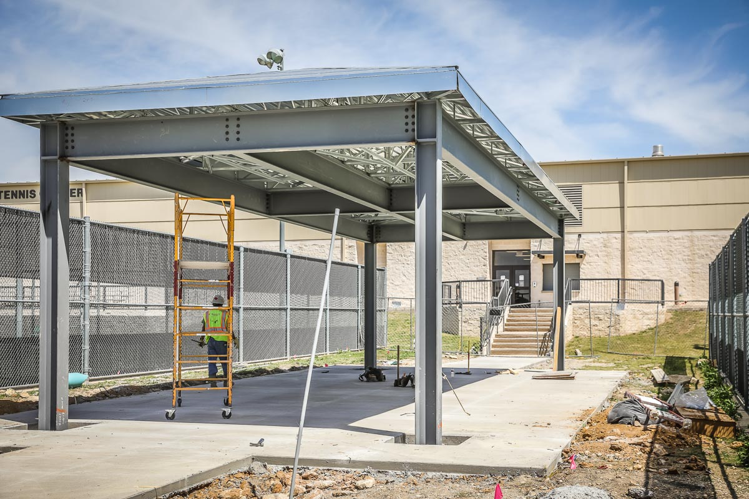
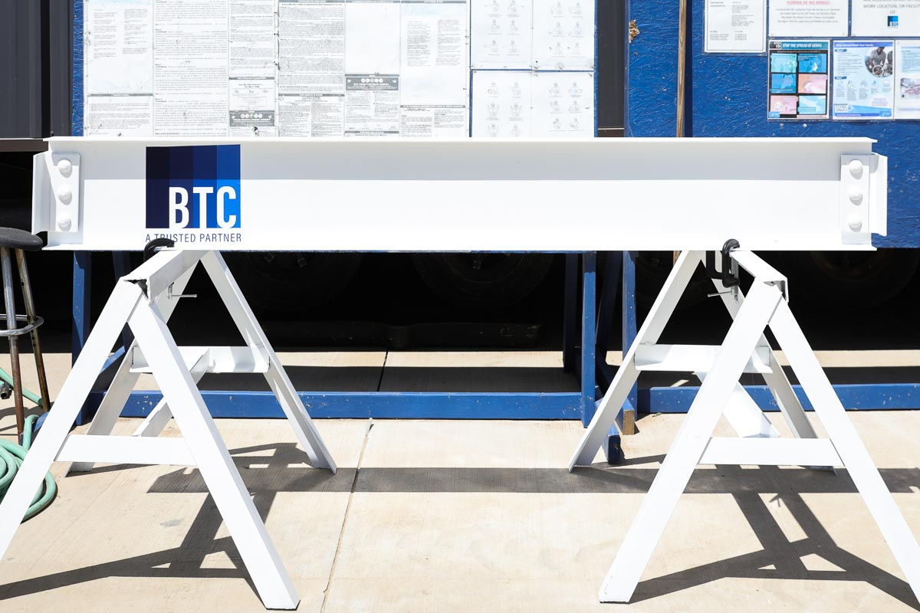
This is last structural beam to be installed and was autographed by Boswell students.
Roofing on the tennis pavilion has been completed.

Slide 7
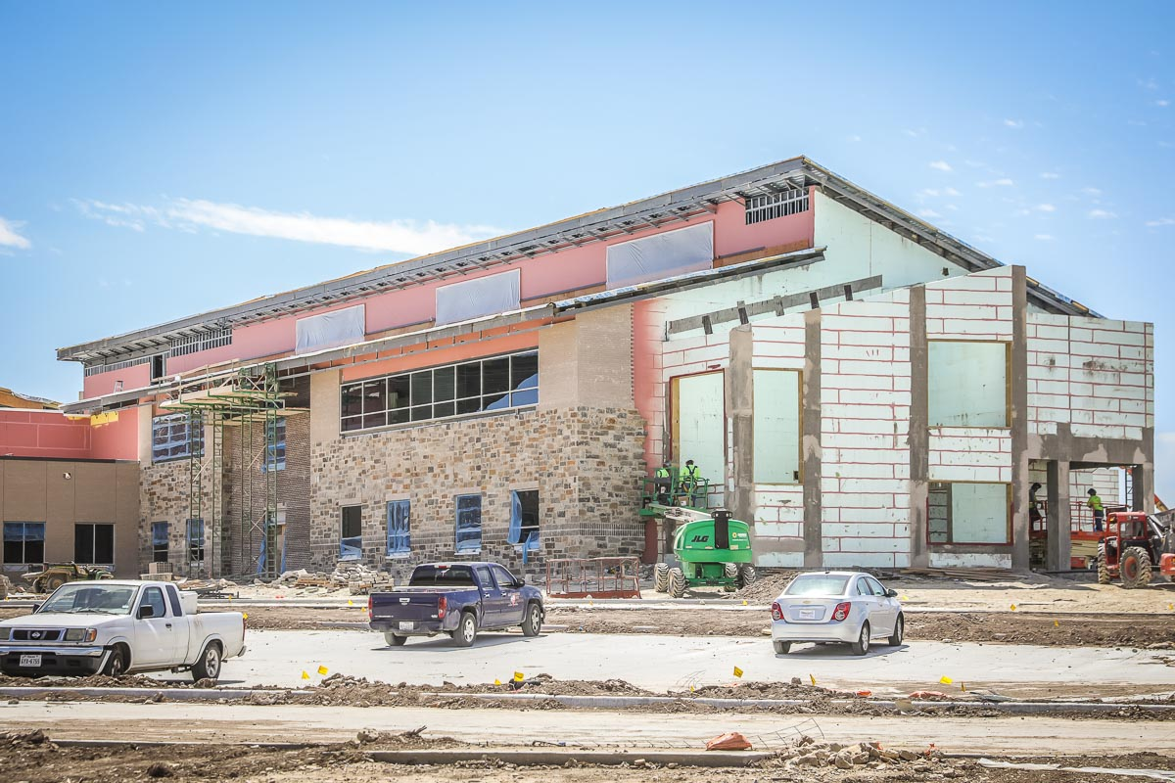
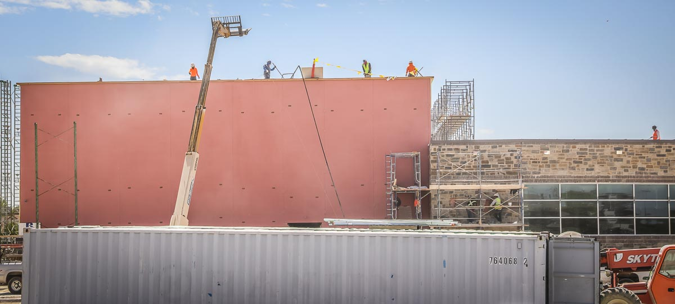
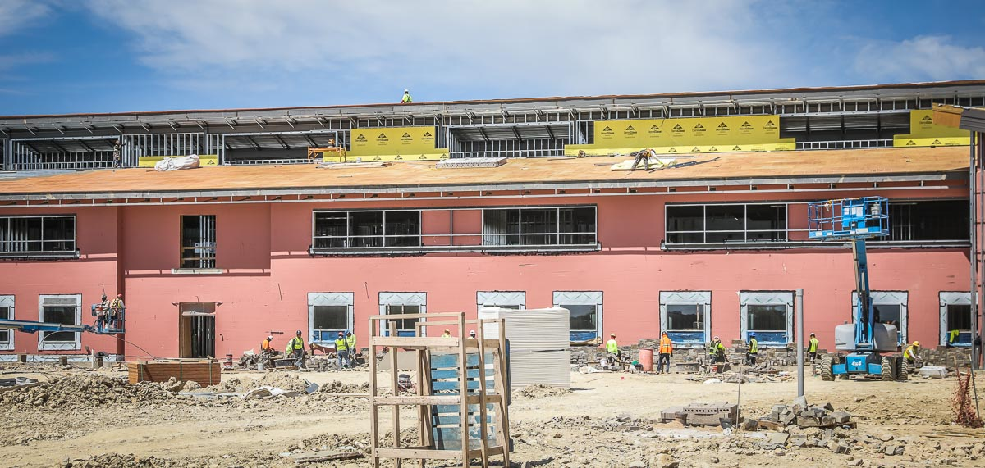
LAKE COUNTRY ES
Roofing and rock work continue to progress throughout the exterior of the building.

Slide 8
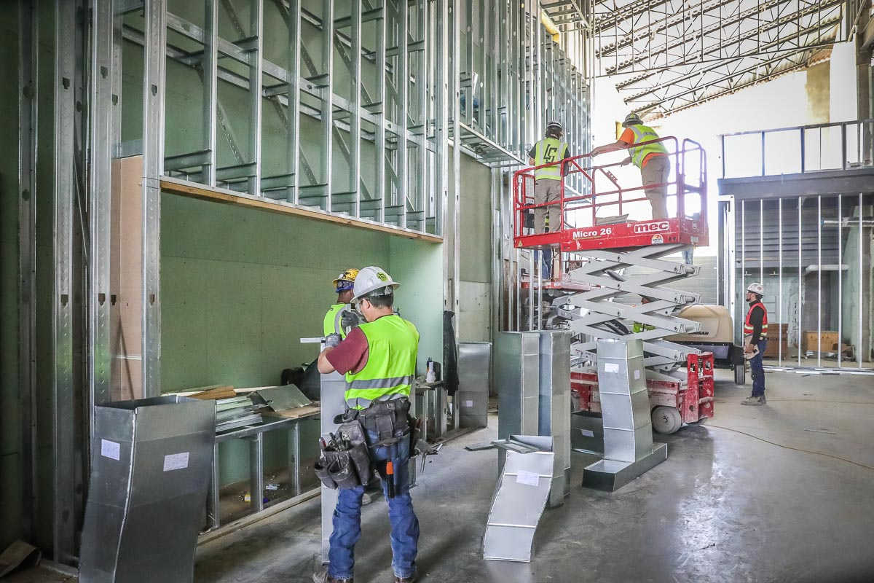
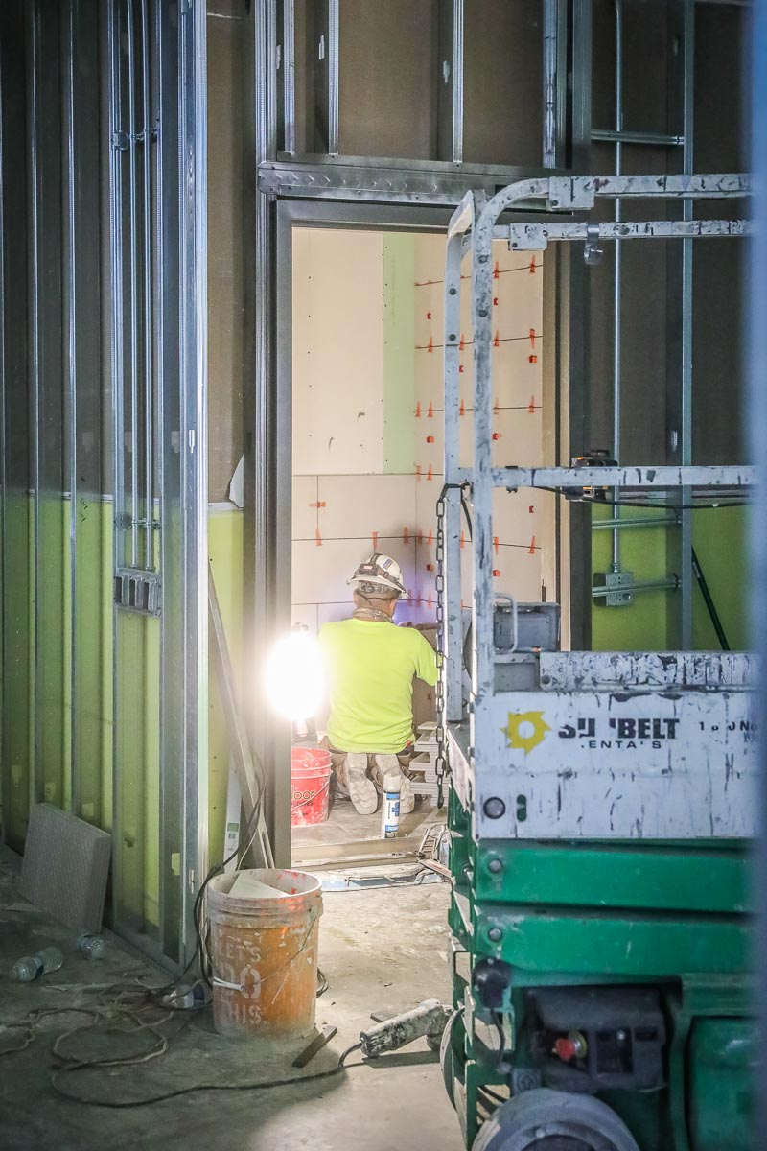
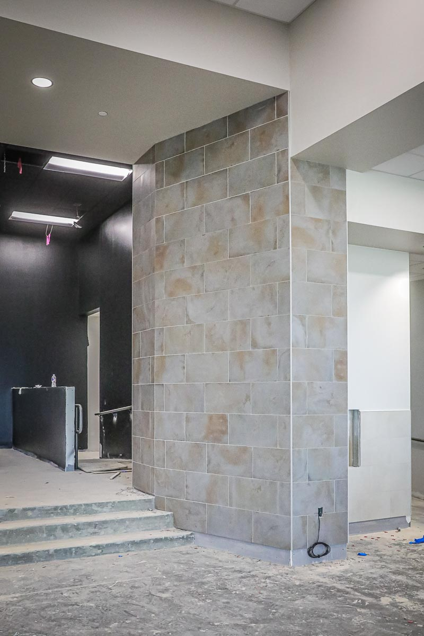
Interior framing in the main hallway has been completed. Tile on the stage is complete and installation will begin this week in the main foyer.

Slide 9
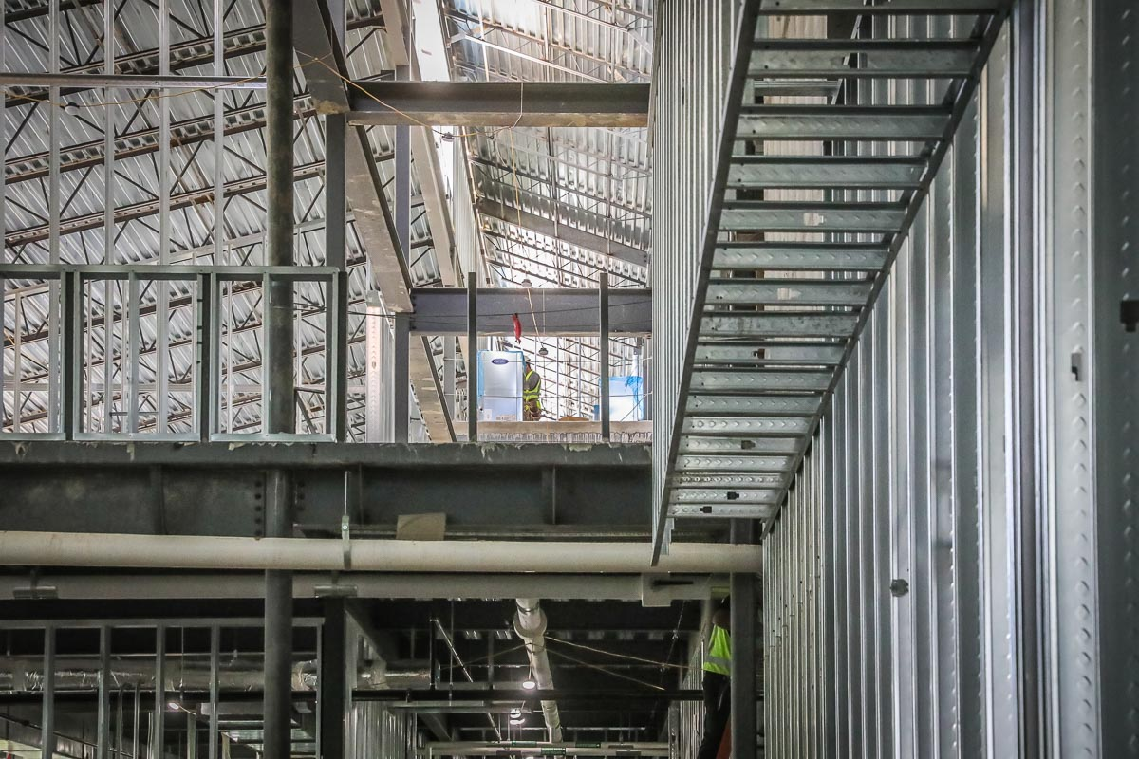
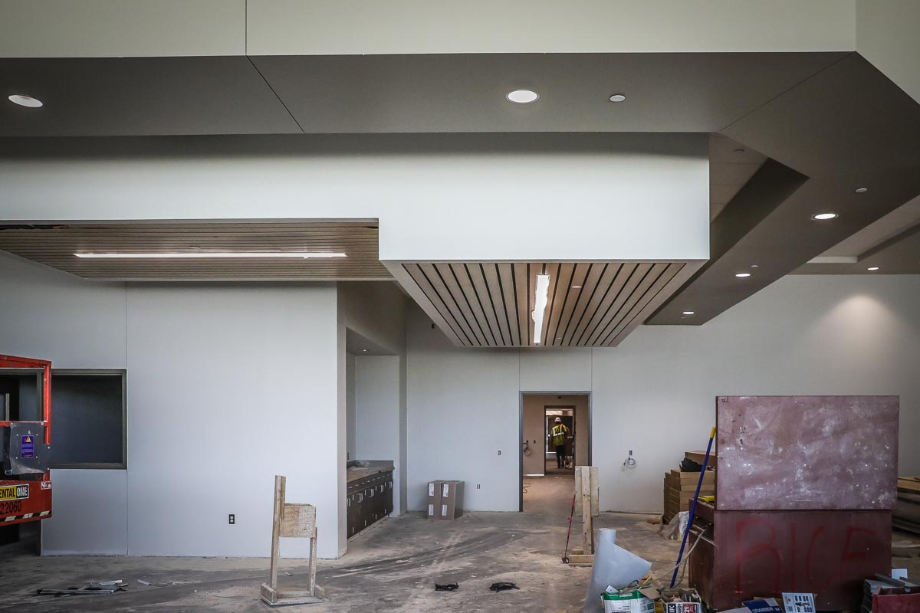
Drop-down ceiling in the library has been completed.
Framing and HVAC continue on the second level.

Slide 10
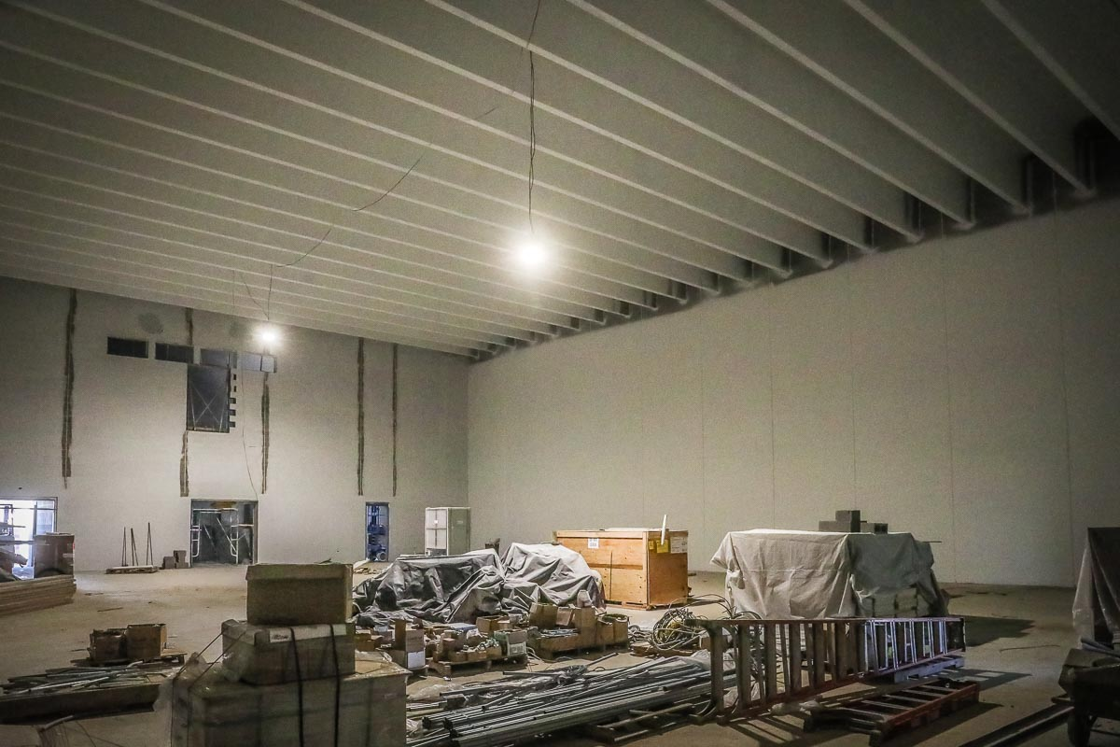
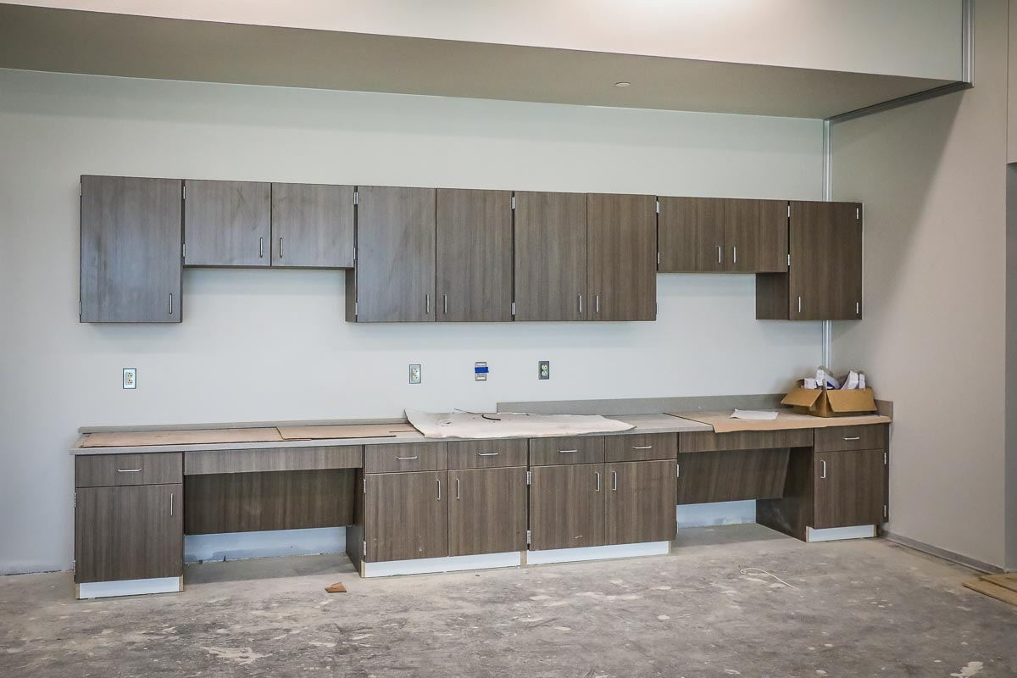
Millwork in the music/art room has been installed. CMU block in the gym is completed. A primer paint has been applied and waiting for final coat of paint.

Slide 11
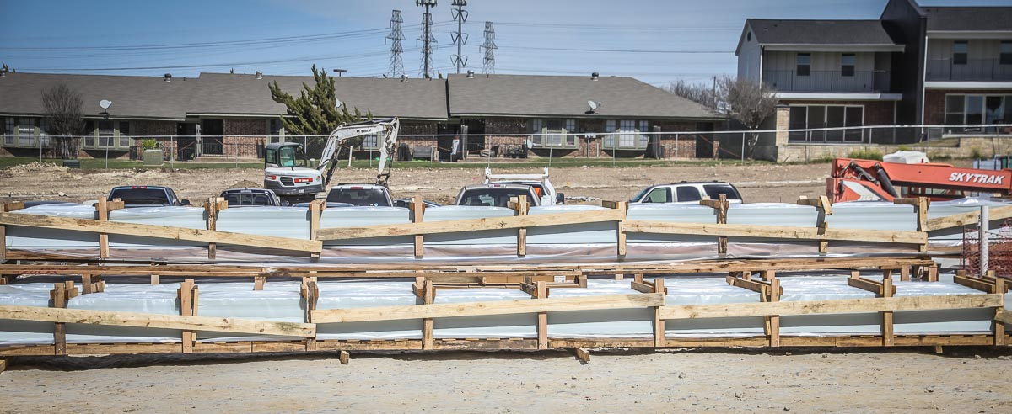
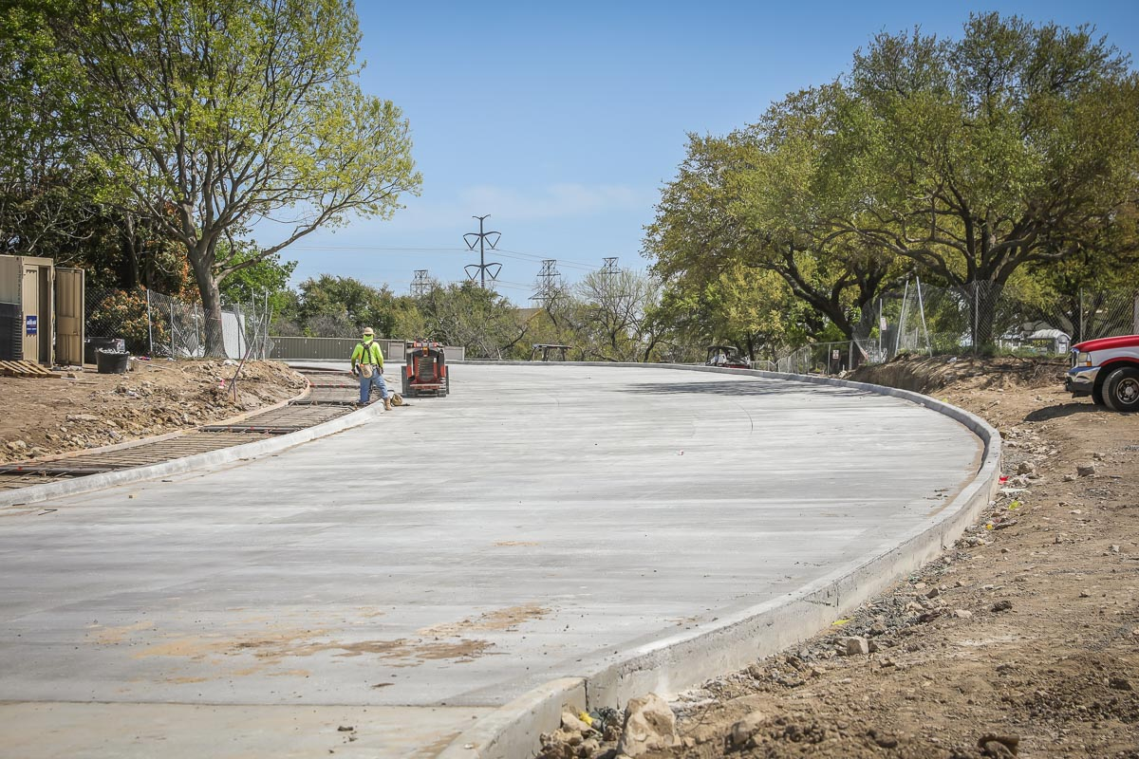
Metal roof panels have arrived on site waiting for installation. Spring Street entrance has been poured connecting with the bus loop.

Slide 12
Name an Architect of Record
Lake Country Elementary is the third school with the same design prototype.
The District has one additional elementary school in the current bond program.
Naming the Architect of Record will allow approximately 10 months to develop a new prototype for upcoming projects for consideration.

